Slide 1
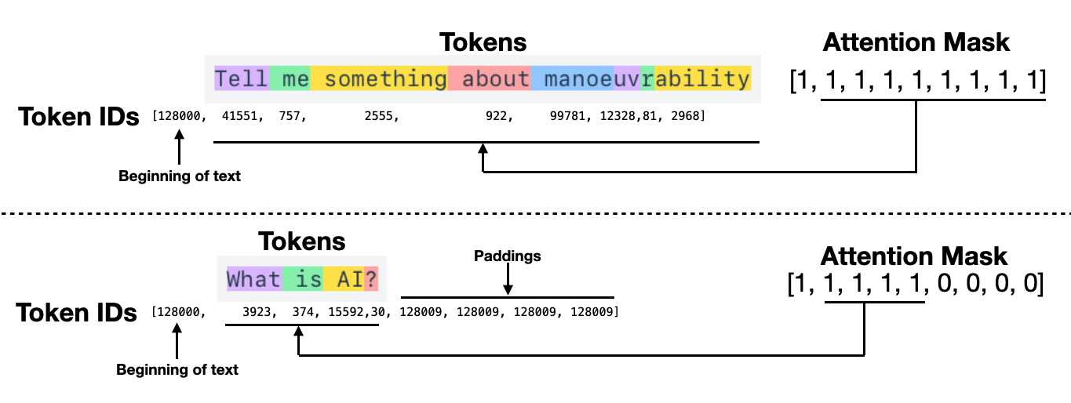
Tokenization: From Text to Numerical IDs
Tokenization is the process of breaking down raw text into smaller units called "tokens" so computers can process them.
Word Tokenization: Each unique word is assigned a specific integer ID.
Character Tokenization: Each individual letter is treated as a token, which helps with spelling but loses semantic meaning.
BPE (Byte Pair Encoding): A sub-word tokenization method used by modern LLMs to handle rare words and prevent "out-of-vocabulary" errors.

Slide 2
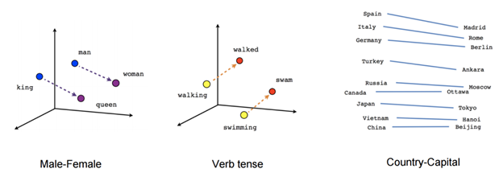
Word Vectors: Turning Words into Mathematics
Word Vectors represent text as coordinates in high-dimensional space.
Word2Vec & GloVe: These are traditional algorithms that turn words into math based on their neighboring words in a dataset.
Unlike simple IDs, these vectors capture semantic relationships (e.g., the distance between "King" and "Queen" is similar to "Man" and "Woman").

Slide 3
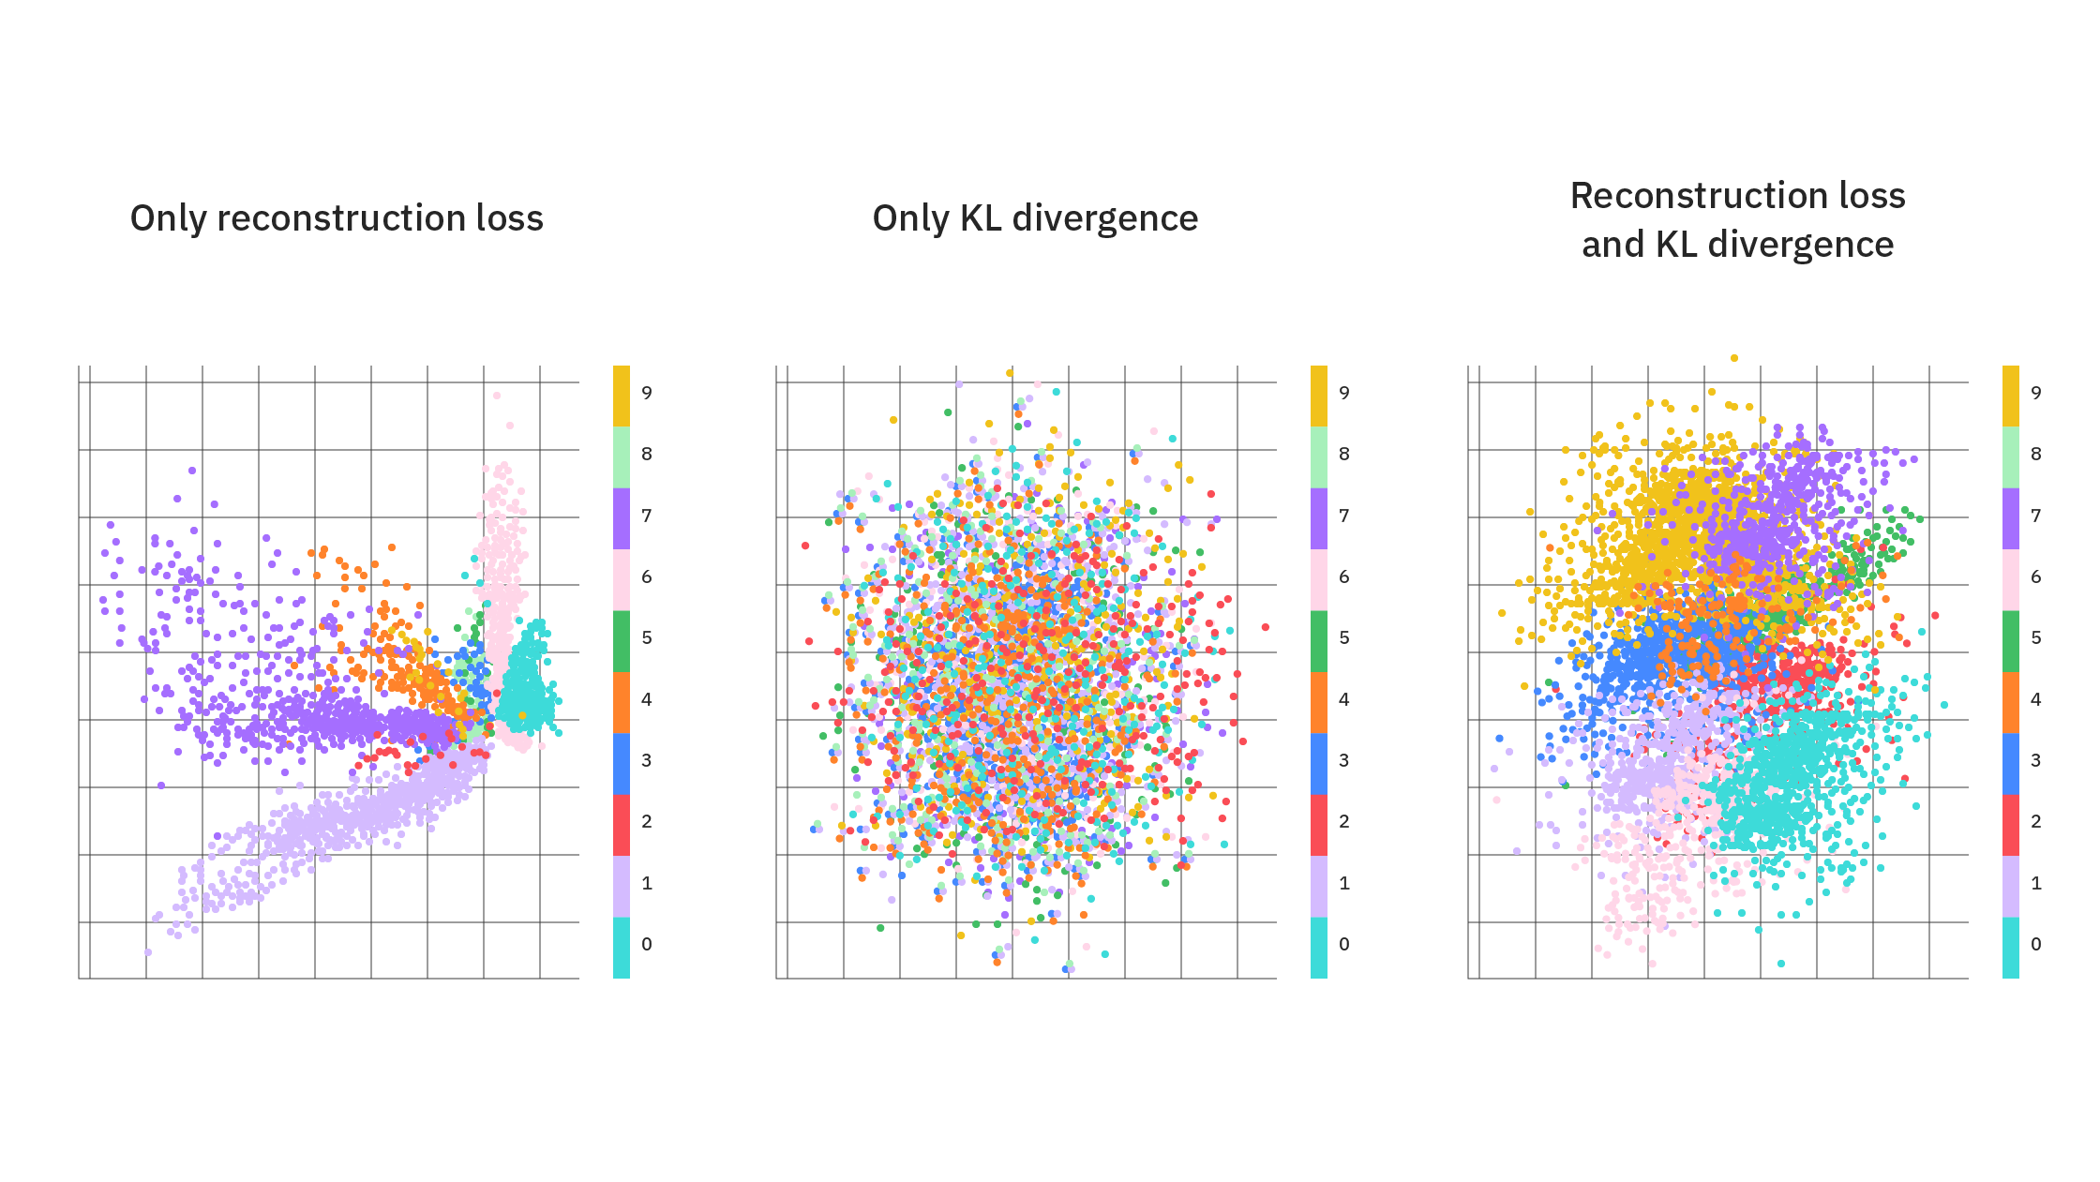
Latent Space: Visualizing Meaning
The "Latent Space" is the mathematical map where all word vectors live.
AI understands context by placing related words like "Doctor" and "Hospital" close to each other mathematically.
By calculating the distance between vectors, the AI can determine how similar two pieces of text are.

